Slide 1



23CS1512 – SOCIALLY RELEVANT MINI PROJECT

Slide 2
AI-Powered AutoFill Patient Discharge System
Team Members:
Vindhya S (Reg No: 211423104739)
Yamini P (Reg No: 211423104748)
Department: Computer Science and Engineering
Guide Name: Dr. Subedha. V
Coordinator Name: Dr. Subedha. V
Domain: Artificial Intelligence
SDG 3 – Good Health and Well-Being

Slide 3
Agenda
Introduction
Problem Statement
Objectives
Literature Survey
Proposed System and Architecture
UML Diagrams
Modules
Algorithm and Methodology
Implementation Plan
Tools used
Test cases
Screenshots
Conclusion
Future Work
References

Slide 4
Introduction
AI-Powered Autofill Patient Discharge System
Manual discharge summaries are time-consuming and prone to errors.
The system uses AI to automatically generate accurate, editable summaries from patient data.
It integrates with hospital databases to create multilingual, structured reports.
Includes recovery graphs, medication schedules, and personalized diet plans for improved patient care.

Slide 5
Problem Statement
Preparing patient discharge summaries manually is time-consuming and often takes several hours, causing delays in hospital discharge. Moreover, many patients do not fully understand these summaries due to complex medical language, leading to wrong medicine intake, missed follow-ups, and increased health complications.
SDG 3 – Good Health and Well-Being
Target 3.c - Strengthens health systems and workforce efficiency through AI-based discharge automation.

Slide 6
Objectives
Automate the generation of patient discharge summaries using AI.
Enable doctor verification and editing before final approval.
Visualize patient recovery progress through graphs.
Support multilingual summary generation for wider accessibility.
Improve discharge process accuracy, consistency, and efficiency.

Slide 7
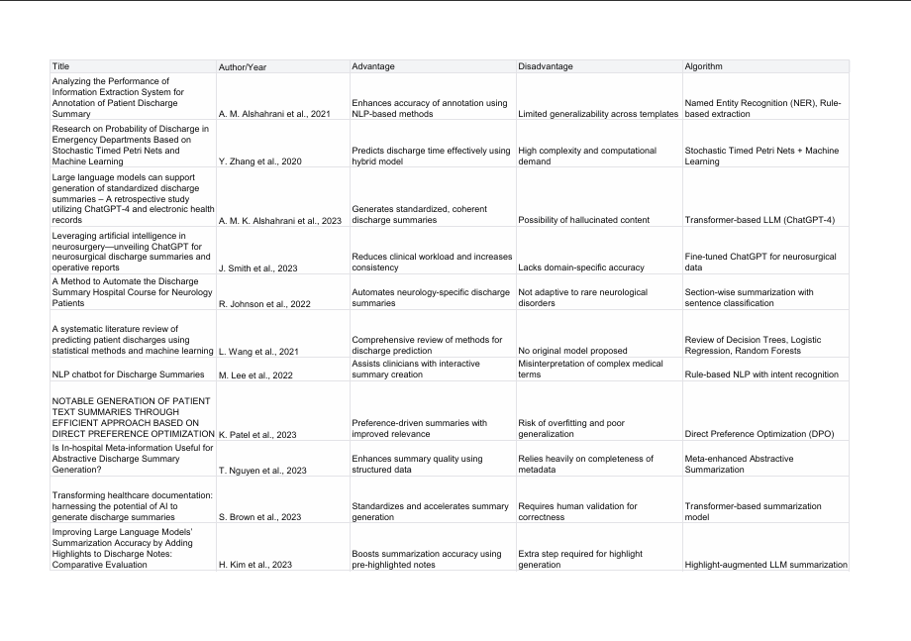
Literature Survey​

Slide 8
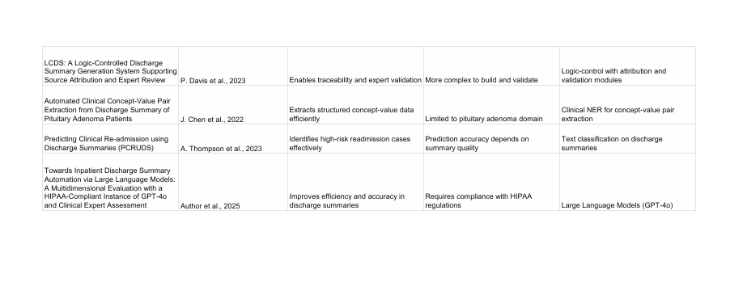

Slide 9
Proposed Solution
Uses AI and NLP to automatically generate discharge summaries from hospital databases.
Provides doctor authentication and an editable interface for verification and modifications.
Generates multilingual summaries for broader accessibility.
Displays recovery graphs and medication plans to visualize patient progress.

Slide 10
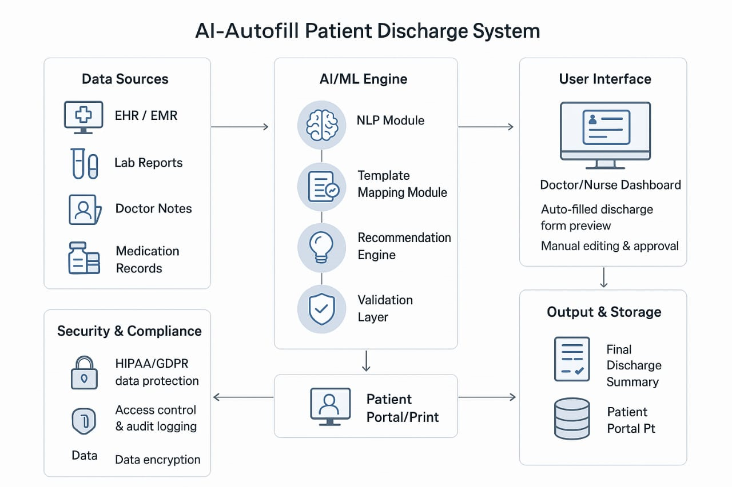
Architecture Diagram

Slide 11
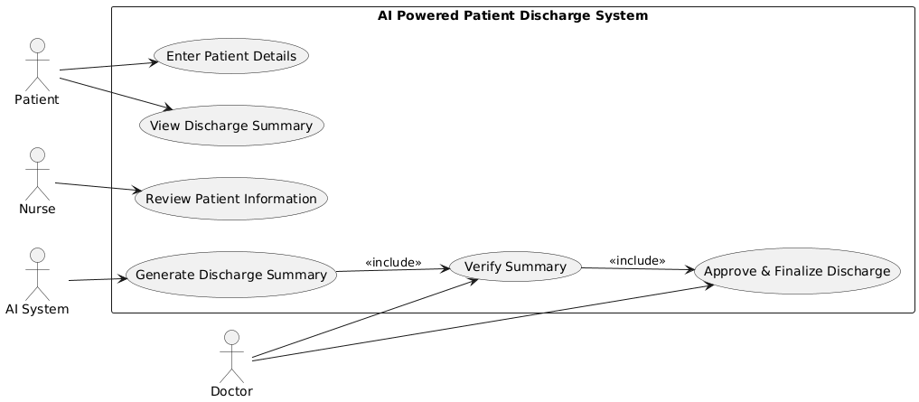
Use Case Diagram

Slide 12
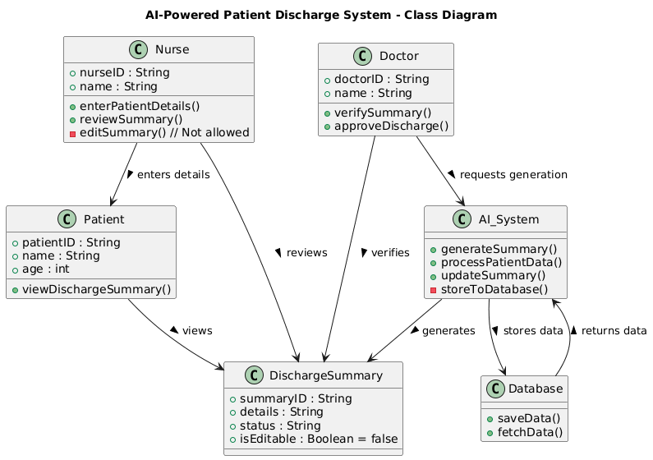
Class diagram

Slide 13
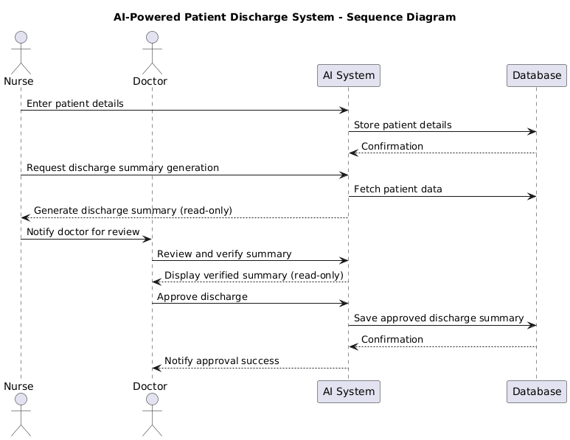
Sequence Diagram

Slide 14
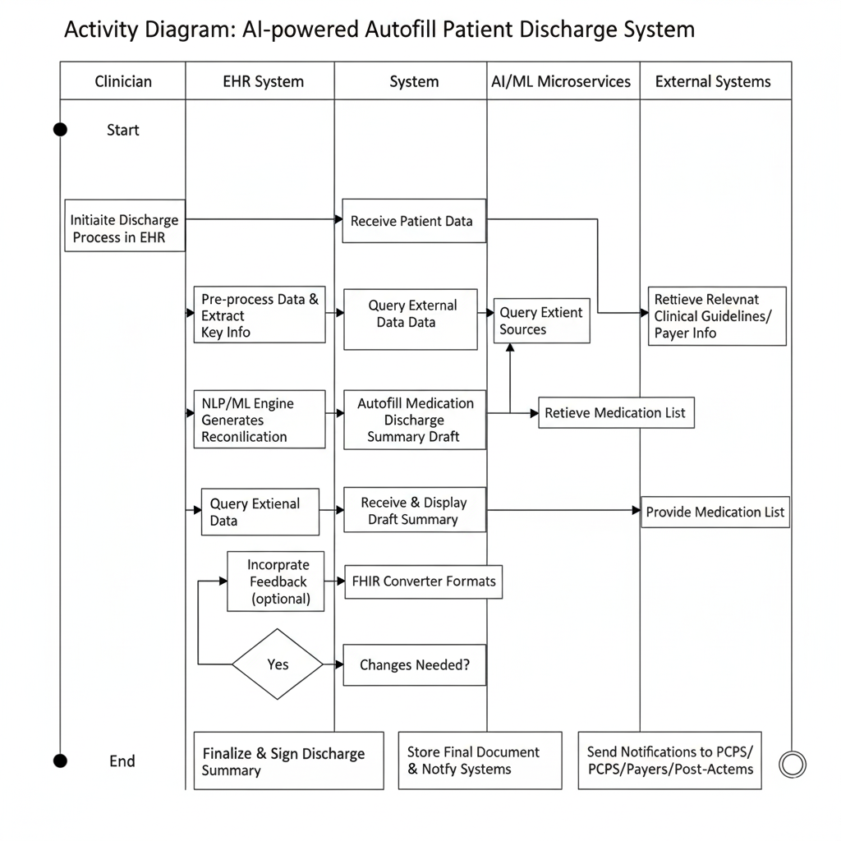
Activity Diagram

Slide 15
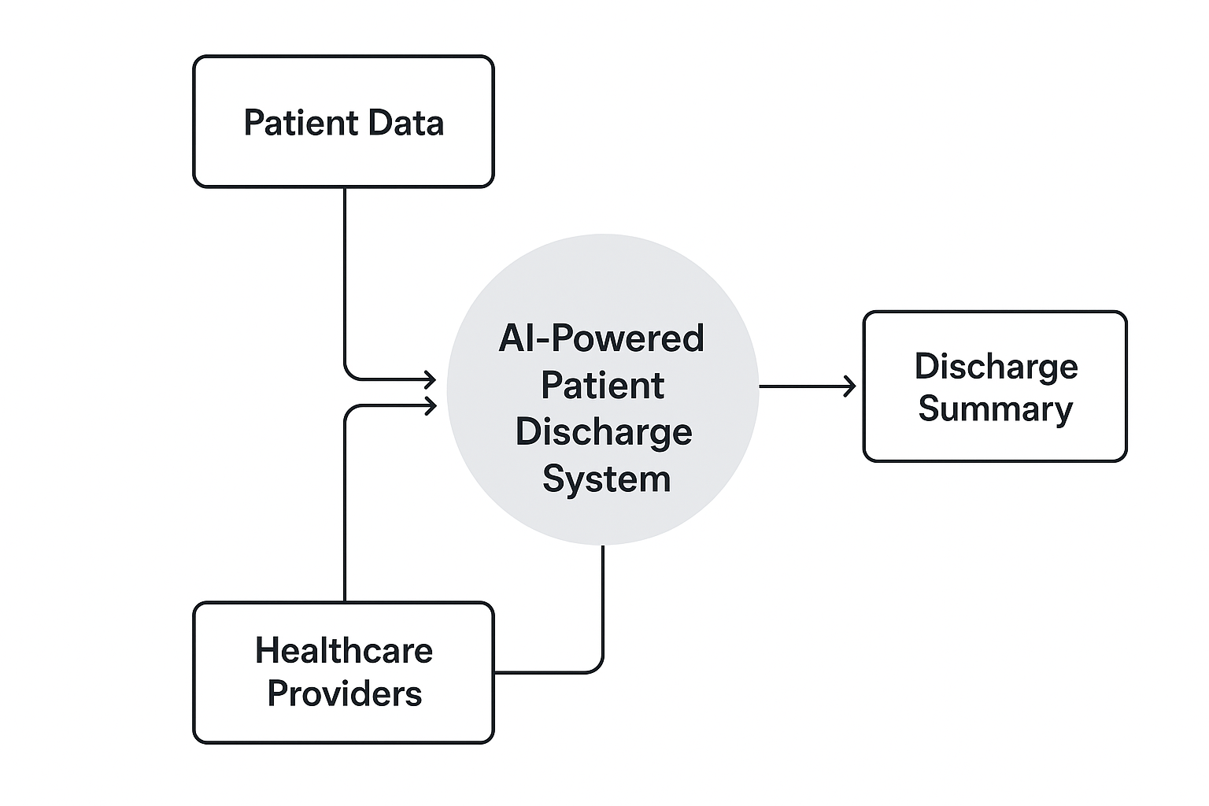
Dataflow Diagram(Level 0)

Slide 16
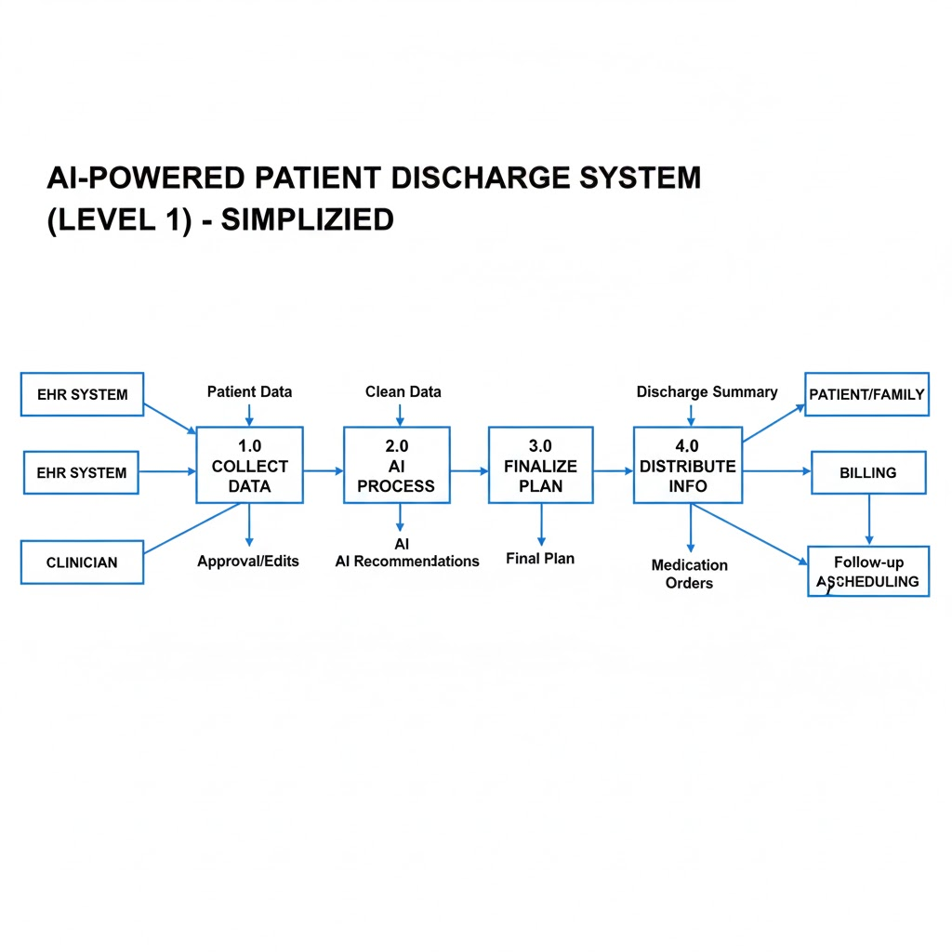
Dataflow Diagram(Level 1)

Slide 17
Modules
User Authentication Module
Data Input Module
AI Summary Generation Module
Doctor Review Module
Visualization Module
Multilingual Conversion Module

Slide 18
Algorithm and Methodology
Collect patient data from medical notes and reports.
Preprocess text using NLP techniques.
Extract key clinical entities like diagnosis and medication.
Generate discharge summary using LLM-based summarization.
Autofill and verify the discharge form by the doctor.

Slide 19
Implementation Plan
EHR data input
AI processing
Language
translation
visual chart creation
patient access and review.
doctor verification

Slide 20
Tools
Python
spaCy/NLTK
Google Translate API
Pandas
Matplotlib/Plotly
ReportLab/FPDF
CSV
Tkinter
Twilio API

Slide 21
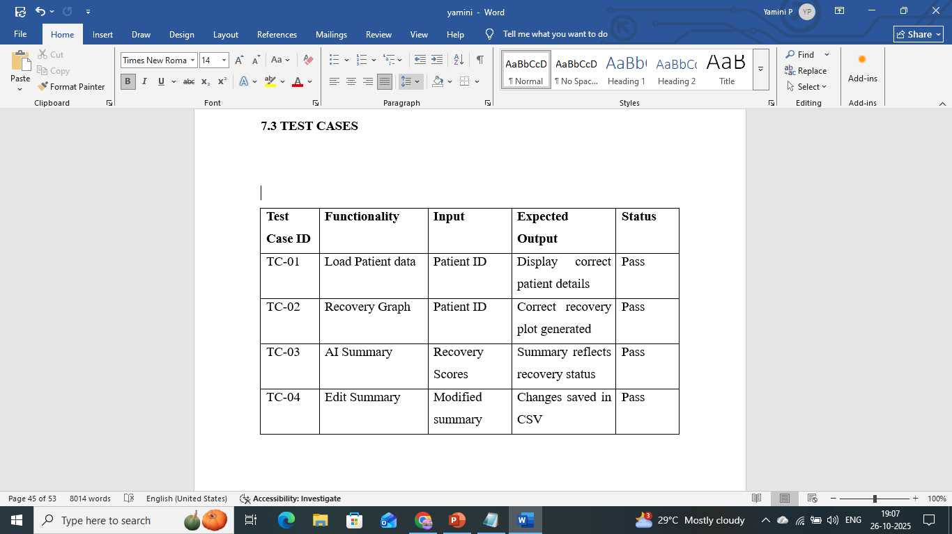
Test Cases

Slide 22
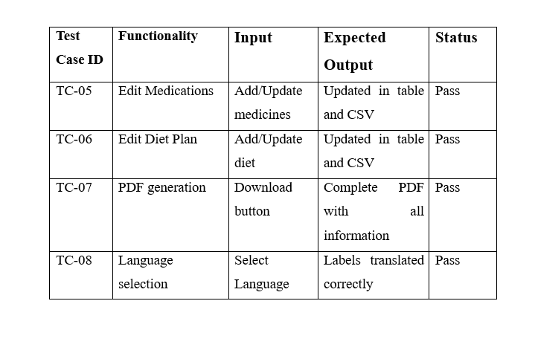
Test Cases

Slide 23
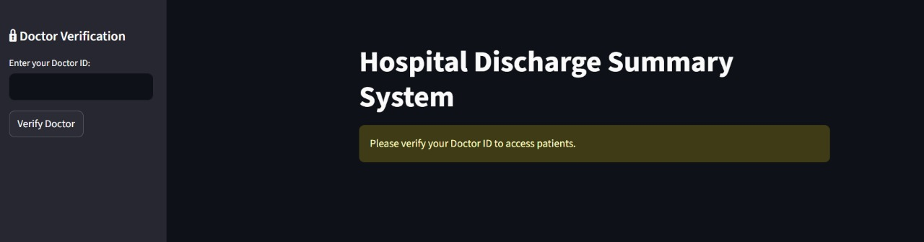
Doctor Login Page

Slide 24
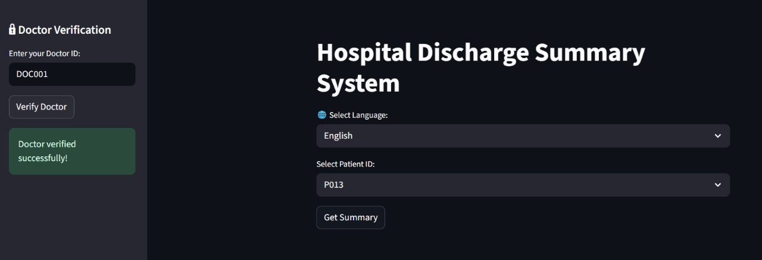
Discharge Summary System

Slide 25
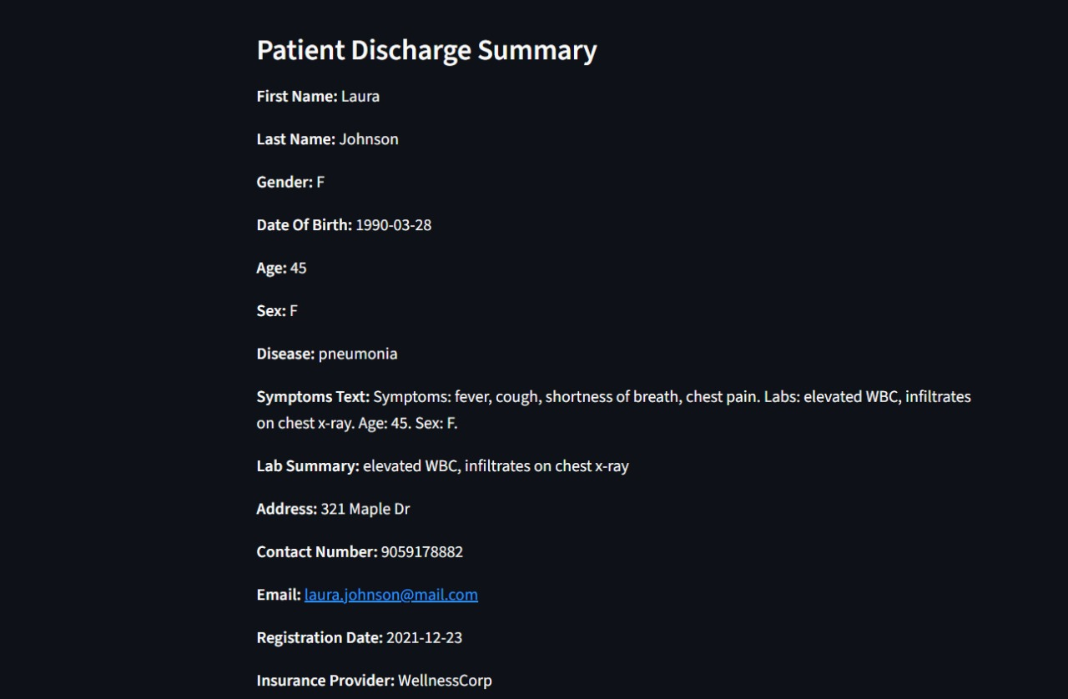
Sample Discharge Summary

Slide 26
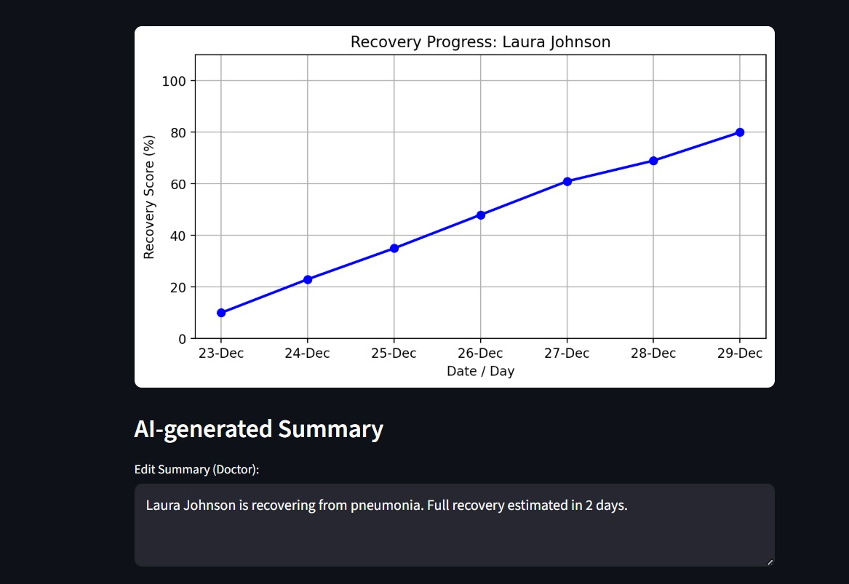
Recovery Graph

Slide 27
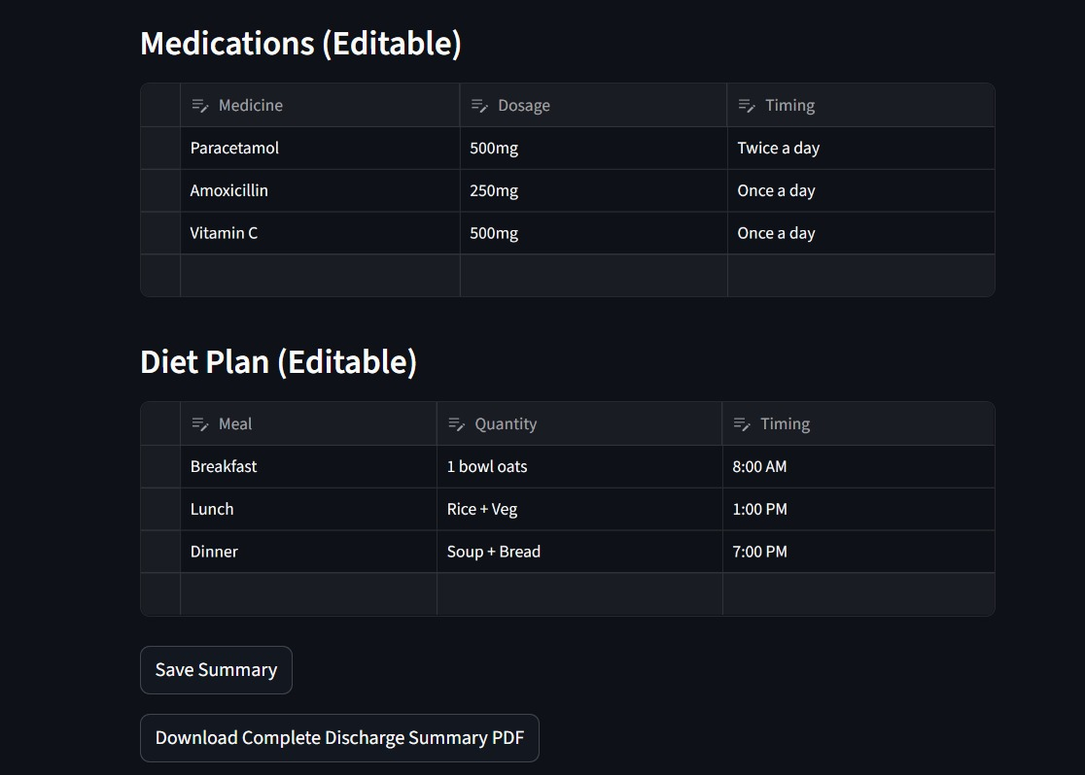
Medication and Diet Plan

Slide 28
Conclusion
The AI-powered automated discharge system demonstrates how NLP and transformer models can generate accurate, standardized, and efficient medical summaries. It reduces clinician workload, minimizes errors, and improves communication in healthcare. Though challenges such as hallucinated content and domain-specific limitations exist, the system holds strong potential for reliable integration with electronic health records in the future.

Slide 29
Future Work
Collaborations with NGO’s and Private hospital
Telemedicine Compatibility
Integrate with Ayushman Bharat (ABDM) platform
Provide discharge details in audio (voice-based support)
DPDP Compliance

Slide 30
References
https://ieeexplore.ieee.org/document/10056575
https://ieeexplore.ieee.org/document/10677826
https://pmc.ncbi.nlm.nih.gov/articles/PMC10654848/
https://ieeexplore.ieee.org/document/6498244

Slide 31
References
https://www.researchgate.net/publication/373449221_A_method_to_automate_the_discharge_summary_hospital_course_for_neurology_patients
https://pmc.ncbi.nlm.nih.gov/articles/PMC12122782/
https://ieeexplore.ieee.org/abstract/document/8969045

Slide 32
Thank you

